Slide 1
Abstract Data Structures
TOPIC 5.0 – ABSTRACT DATA STRUCTURES
TOPIC 5
5.1.1 – 5.1.3: Recursion

Slide 2

REVIEW REVIEW REVIEW REVIEW REVIEW REVIEW
THE WARM-UP QUESTION
Write a python method that is the constructor method for a class called Plant that has a few attributes (variables) that it brings in and assigns

Slide 3
REVIEW REVIEW REVIEW REVIEW REVIEW REVIEW
THE WARM-UP ANSWER
Write a python method that is the constructor method for a class called Plant that has a few attributes (variables) that it brings in and assigns

Slide 4
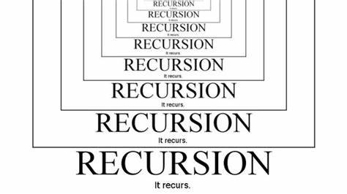
Topic 5.1.1 – THINKING RECURSIVELY
Recursive thinking
Different way of tackling problems
Continually breaking down a problem into smaller versions of itself
Eventually, you hit a small enough problem to solve yourself
Recursion is the process of breaking down a problem into smaller pieces which you either already know the answer to, or can solve by applying the same process to each piece, and combining the results.

Slide 5
Topic 5.1.1 – THINKING RECURSIVELY
PRACTICAL EXAMPLE
Think about your path being blocked by a big rock
You can split this big rock in two, then split those halves, so on and so forth until you can pick up the rocks to clear the path

Slide 6
Topic 5.1.2 – THINKING RECURSIVELY
Slightly less practical example
Go to mathisfun.com/games/towerofhanoi.html
The Towers of Hanoi are the quintessential example of a recursive algorithm
You must move all the discs from the left tower to the right tower, in order
You can only move one disk at a time
Smaller discs may NOT be placed under larger discs
Try to solve the towers for 3 discs, then 5, then 7

Slide 7
Topic 5.1.2 – THINKING RECURSIVELY
Towers of hanoi
The towers of Hanoi increases dramatically in time taken to solve with each increase
You must break down the problem step-by-step to move each disc
Each disc movement requires you to do a handful of prior disc movements
By the time you’ve added one new disk, you must once again move every other disk again
O(2^{n}) algorithm (not very efficient)

Slide 8
Topic 5.1.3 – THINKING RECURSIVELY
Towers of hanoi
General algorithm:
Move n – 1 discs from tower A to tower B, leaving disc n on tower A
Move disc n from tower A to tower C
Move n-1 discs from tower B to tower C

Slide 9
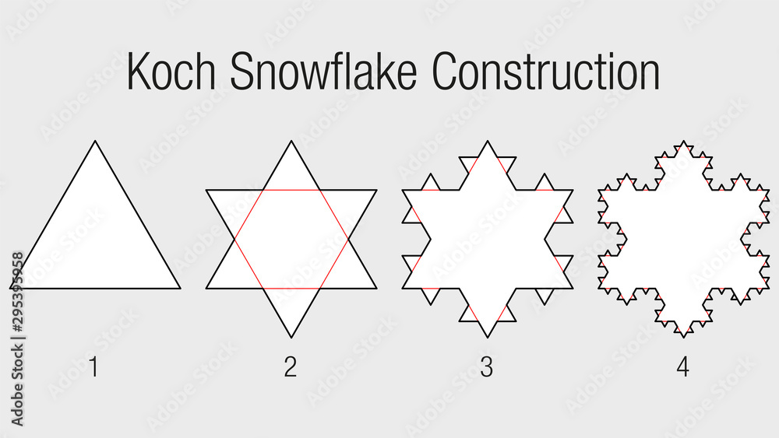
Topic 5.1.1 – THINKING RECURSIVELY
Koch’s snowflake
Each recursive step adds a new layer of triangles

Slide 10
Topic 5.1 – THINKING RECURSIVELY
Okay big man how do I code it?
First off, that was kind of mean
Second off, recursion typically happens using procedures
The procedures check to see if the problem is broken down enough, if not, they break it down some more

Slide 11
Topic 5.1 – THINKING RECURSIVELY
Okay big man how do I code it?
To break down the problems, we construct our functions to call themselves over again
This allows us to repeat our steps of breaking down the problem
Let’s analyze the Fibonacci sequence to look at an example of recursion

Slide 12
Topic 5.1 – THINKING RECURSIVELY
FIBONACCI SEQUENCE
Base case: f(0) = 1 and f(1) = 1
f(x) = f(x-1) + f(x-2)
f(2) = f(1) + f(0)
f(2) = 1 + 1
f(2) = 2
f(3) = f(2) + f(1)
f(3) = 2 + 1
f(3) = 3

Slide 13
Topic 5.1 – THINKING RECURSIVELY
FIBONACCI SEQUENCE CODE
def fibonacci(n):
if(n == 0 or n == 1):
return 1
else:
return fibonacci(n-1) + fibonacci(n-2)

Slide 14
Topic 5.1 – THINKING RECURSIVELY
FIBONACCI SEQUENCE CODE
The Fibonacci code checks if the base case is met
If the base case is not met, we call the function again
We’ll call this the ‘recursive case’
With very little code, we have a recursive function

Slide 15
Topic 5.1 – THINKING RECURSIVELY
FIBONACCI SEQUENCE CODE
The Fibonacci code checks if the base case is met
If the base case is not met, we call the function again
We’ll call this the ‘recursive case’
With very little code, we have a recursive function

Slide 16
Topic 5.1 – THINKING RECURSIVELY
FACTORIAL
Base case: f(0) = 1
f(x) = x * f(x-1)
f(3) = 3 * f(2)
f(3) = 3 * 2
f(3) = 6
f(4) = 4 * f(3)
f(4) = 4 * 6
f(4) = 20

Slide 17
Topic 5.1 – THINKING RECURSIVELY
FIBONACCI SEQUENCE CODE
def factorial(n):
if n == 0:
return 1
else:
return n * factorial(n-1)

Slide 18
Topic 5.1 – THINKING RECURSIVELY
PRACTICAL USAGE
Lots of problems that can be solved by while loops can also be solved using recursion
Let’s take a look back at our binary search from Topic 4

Slide 19
Topic 5.1 – THINKING RECURSIVELY
BINARY SERACH (ITERATIVE)
def binarySearch(want, arr):
high = len(arr)-1
low = 0
while low <= high:
mid = low + (high - low) // 2
if want == arr[mid]:
return mid
elif arr[mid] < want:
low = mid + 1
else:
high = mid - 1
return -1

Slide 20
Topic 5.1 – THINKING RECURSIVELY
BINARY SERACH (Recursive)
def binarySearch(want, arr, low, high):
if low > high:
return -1
mid = (low + high) // 2
if arr[mid] == want:
return mid
elif arr[mid] < target:
return binarySearch(want, arr, mid + 1, high)
else:
return binarySearch(want, arr, low, mid – 1)

Slide 21
Topic 5.1 – THINKING RECURSIVELY
PRACTICAL USAGE
The recursive code is shorter! Woo-hoo!
For writing code, recursive algorithms can often be much simpler to write
There is a tradeoff, as each iteration of the recursion takes more memory
This can lead to memory overflows if the algorithm has to recurse too much

Slide 22

Topic 5.1 – THINKING RECURSIVELY
VOCAB TO REMEMBER
Recursion
Base Case
Recursive Case

